Slide 1
NodeJS & Express for ASP.NET MVC Developers
By Md. Alim Ul Karim
Microsoft Community Day
On behalf of Microsoft Technical Community Bangladesh

Slide 2
Outline
RESTful: Representational state transfer
Why RESTFul?
What is NodeJS?
JavaScript & NodeJS for C# Developers
Introduction to Express
NodeJS and Express for ASP.NET MVC Developers and Web Api developers

Slide 3
RESTful
Representational state transfer

Slide 4
REST : Representational state transfer
api.site.com/resource
Should return list of resource [if http header method = “Get”]
api.site.com/resource/id
Get the single item by ID [if http header method = “Get”]

Slide 5
RESTful Header Methods
GET | PUT | POST | DELETE | [PATCH]
Entire List or Single | Entire List or Single | Entire List or Single | Entire List or Single | Single
Gets resources | Create or Update | Create | Delete | Updates [Single]
Details : http://bit.ly/2ASDgsp

Slide 6
RESTful Header Methods
GET : R | PUT : C | POST : U | DELETE : D | [PATCH]
Entire List or Single | Entire List or Single | Entire List or Single | Entire List or Single | Single
Gets resources | Create or Update | Create | Delete | Updates [Single]
Read | Create | Update | Delete | X
Details : http://bit.ly/2ASDgsp

Slide 7
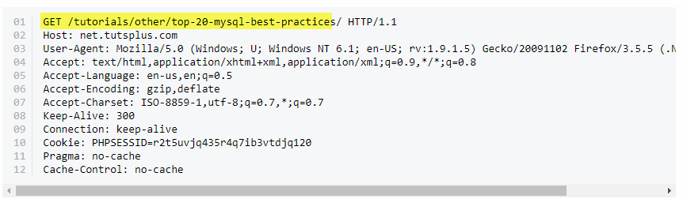
Http Header (Request)

Slide 8
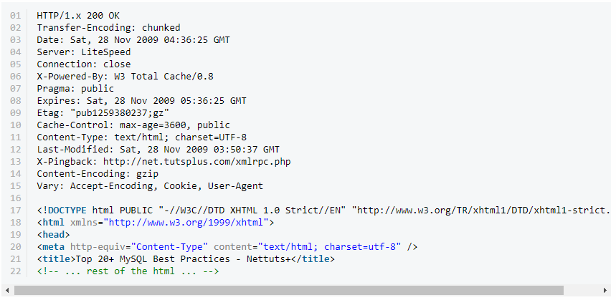
Http Header (Response)

Slide 9
Use POSTMAN to debug your apis

Slide 10
NodeJS
What is NodeJS?

Slide 11
JavaScript for C# Developers

Slide 12
Variables
C#
JavaScript
var newVariable = "Hello World";
var newVariable = "Hello World";

Slide 13
Variables
C#
JavaScript
var newVariable = "Hello World";
newVariable = 12; // can’t
var newVariable = "Hello World";
newVariable = 12; // we can

Slide 14
Variables
C#
JavaScript
var newVariable = "Hello World";
newVariable = 12; // can’t
var newVariable = "Hello World";
newVariable = 12; // we can
Strongly Typed
Loosely Typed

Slide 15
Variables
C#
JavaScript
dynamic newVariable = "Hello World";
newVariable = 12; // we can
var newVariable = "Hello World";
newVariable = 12; // we can
Strongly and weakly Typed
Loosely/Weakly Typed

Slide 16
Fun things in JS V8 Engine

Slide 17
Buzzword : JS V8 Engine
Google Development Center Germany | OS | NodeJS & Chrome | Fast | C++ | JIT

Slide 18
JS V8 Declarations
Declaration | Block/Global | Changeable | Immutable
var | Global | Yes | No
let | Block | Yes | No
const | Block | No | No
class | Block | No | No
Object.freeze() |  |  | Yes
http://exploringjs.com/es6/ch_variables.html

Slide 19
Object Oriented Programming
C# OOP : Class
JavaScript OOP : Class
public class Person {
public Person(string firstName, string lastName) {
this.FirstName = firstName;
this.LastName = lastName;
}
public string FirstName { get; set; }
public string LastName { get; set; }
public void ExampleMethod(string x) {
// todo stuff.
}
var Person = function (firstName, lastName) {
this.FirstName = firstName;
this.LastName = lastName;
this.ExampleMethod = function() {
return this.FirstName + " " + this.LastName;
}
}
var p = new Person("Alim", "Karim");
p.ExampleMethod();

Slide 20
Object Oriented Programming
C# OOP : Class
JavaScript OOP : Class
public class Person {
public Person(string firstName, string lastName) {
this.FirstName = firstName;
this.LastName = lastName;
}
public string FirstName { get; set; }
public string LastName { get; set; }
}
public static class PersonExtension {
public static string ExampleMethod(this Person p) {
return p.FirstName + " " + p.LastName;
}
}
var Person = function (firstName, lastName) {
this.FirstName = firstName;
this.LastName = lastName;
}
Person.prototype.ExampleMethod = function () {
return this.FirstName + " " + this.LastName;
}
var p = new Person("Alim", "Karim");
p.ExampleMethod();
Enhancement when you can’t reach!
Best Practice!
C# OOP : http://bit.ly/2ATYru7

Slide 21
Object Oriented Programming
Standard JS
V8 JS
var Person = function (firstName, lastName) {
this.FirstName = firstName;
this.LastName = lastName;
}
Person.prototype.ExampleMethod = function () {
return this.FirstName + " " + this.LastName;
}
var p = new Person("Alim", "Karim");
p.ExampleMethod();
class Person {
constructor(fname, lname) {
this.FirstName = fname;
this.LastName = fname;
}
ExampleMethod() {
return this.FirstName + " " + this.LastName;
}
}
var p = new Person("Alim", "Karim");
p.ExampleMethod();

Slide 22
Object Oriented Programming
Standard JS
V8 JS
var Person = function (firstName, lastName) {
this.FirstName = firstName;
this.LastName = lastName;
}
Person.prototype.ExampleMethod = function () {
return this.FirstName + " " + this.LastName;
}
var p = new Person("Alim", "Karim");
p.ExampleMethod();
class Person extend SuperClass {
constructor(fname, lname) {
this.FirstName = fname;
this.LastName = fname;
}
ExampleMethod() {
return this.FirstName + " " + this.LastName;
}
}
var p = new Person("Alim", "Karim");
p.ExampleMethod();

Slide 23
Don’t use V8 Codes in Browser
Use it in NodeJS

Slide 24
Express for ASP.NET Developers

Slide 25
Recap : ASP.NET MVC
site.com/controller/action
By default
Lets see some action

Slide 26
Express : App.js
Lets take a look

Slide 27
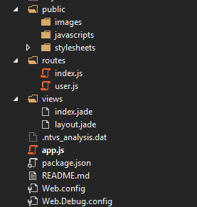
Express : Folder Structure

Slide 28
Express : App.js

Slide 29
Checkout Express Api
http://expressjs.com/en/api.html
// With Content-Type: text/html;
charset=utf-8
req.is('html'); // => 'html'
req.is('text/html'); // => 'text/html'
req.is('text/*'); // => 'text/*' // When Content-Type is application/json
req.is('json'); // => 'json'
req.is('application/json'); // => 'application/json'
req.is('application/*'); // => 'application/*'
req.is('html'); // => false

Slide 30
Let’s Take a look at some coding
Lets take a look

Slide 31
Questions?

Slide 32
Thank you
https://github.com/aukgit/nodejs-for-asp-mvc

